Slide 1

Social Demographic Targeting
Present by: Jie Wang
Sponsor: Viacom
Professor: Matthew Goodwin
Date: December 10

Slide 2
Executive Summary
Project Overview:
1. Viacom is trying to provide social campaigns to client advertisers and make more profit to them. Research will be focus on potential revenue, target demographic and impressions etc.
2. The datasets are about different Viacom accounts on Facebook from January 2018 to September 2019. In addition, the strategies will be provided by the outcomes of the analysis about the datasets.
Project Objectives:
1.Provide advantages and disadvantages of demographic targeting on Viacom’s social channels.
2. Increase the profits for advertisers.
3. Provide Strategies towards potential revenue and target demographic.
Key Processes and Milestones:
1. Project research about the domain and sponsor’s background. 09/14/2020 – 11/08/2020
2. Data analysis: the datasets that provided by Viacom. 10/19/2020 – 11/08/2020
3. Results/Findings & Recommendations. 11/08/2020 – 12/12/2020
Project Outcomes:
Provide different strategies for different accounts and demographic targeting.
Obtain the important factors for advertisings.
Obtain the important CPM values.

Slide 3

Viacom was founded in 1971 and it creates entertainment contents and cultures around the world. In addition, Viacom has television shows, films, digital media as well as programming etc (Viacom, 2020).
The headquarter of Viacom is in New York City, and it was merged with CBS in 2019.
Viacom owns (Viacom, 2020):
1. TV entertainment: CBS Television network, The CW, Decades, CBS Studios, CBS Home Entertainment, CBS Television Stations , CBS Films etc.
2. Cable networks: Entertainment and Youth Group, CMT, Logo, MTV, Smithsonian Channel etc.
3.Global Distribution Group
4. Networks International: Telefe, Channel 5 etc.
5.ViacomCBS science center.
Stock value: 35.87 USD on Dec. 10.
Company Overview

Slide 4

Problem outline
How to increase the benefits of advertising on Viacom social media accounts and make more profits to advertisers?
What rates are good to offer products to partners or advertisers?
How much profits can we have if there’s guaranteed based impressions based on target demographic?
What are the advantages and disadvantages of demographic targeting?

Slide 5
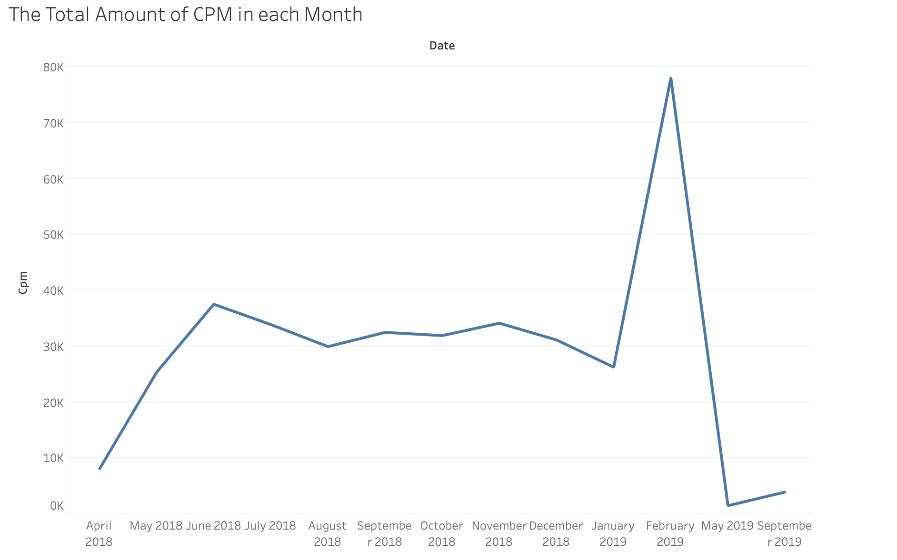
Analysis
CPM is the cost of advertising campaign, and lower CPM means greater advertising strategies (Memon, (2020).
From the graph, the total amount of CPM in each month from 2018 to 2019 can be learned.
The peak is February 2019 and a dramatic increased occurred from January to February. The lowest point is May 2019.
The value of CPM in February 2019 was too high means there was low success in the advertising in that month. However, there was good outcome in May 2019, and it was better than May 2018.
The Total Amount of CPM in Each Month from 2018 to 2019

Slide 6
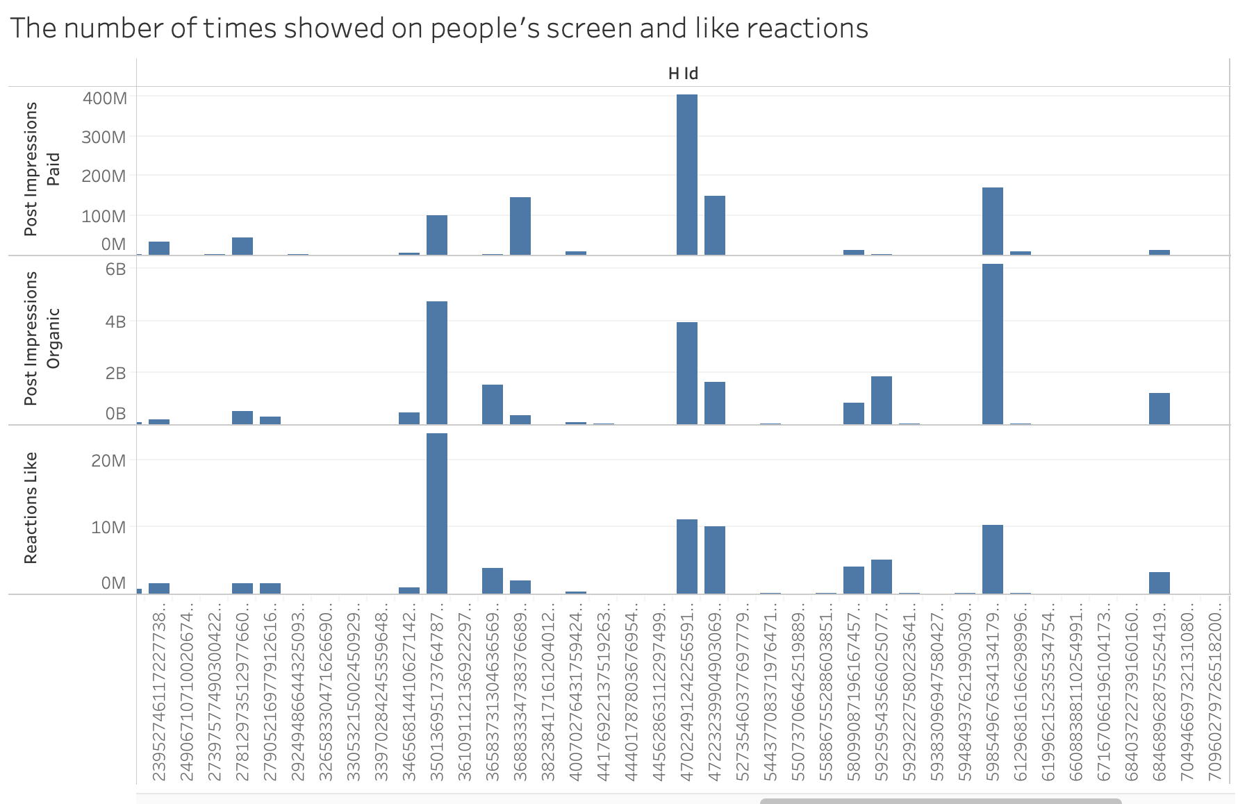
Analysis
From above graph, it can be learned that the number of times from the page showed on person's screen from a paid distribution, the number of times from the page showed on person's screen from an unpaid distribution and the number of like reactions.
In addition, it showed that whether the content is paid or unpaid doesn't affect the numbers of like.
However, the results were only occurred in several accounts, there were other accounts might have opposite results.
The Number of Times Showed on People’s Screen and Like Reactions

Slide 7
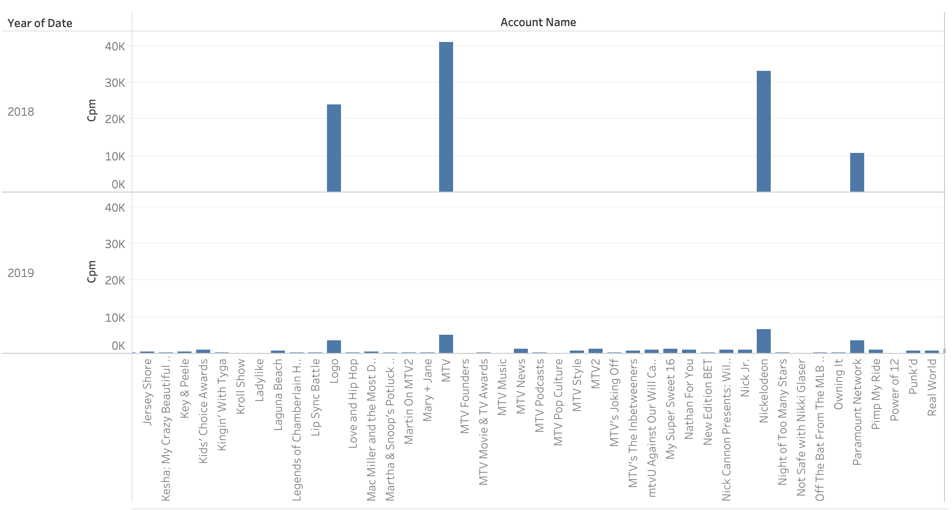
Analysis
From the graph, the total CPM for different accounts in 2018 and 2019 can be learned.
There were accounts that having increased CPM also accounts that having decreased CPM.
The Total CPM for Different Account in 2018 and 2019.

Slide 8
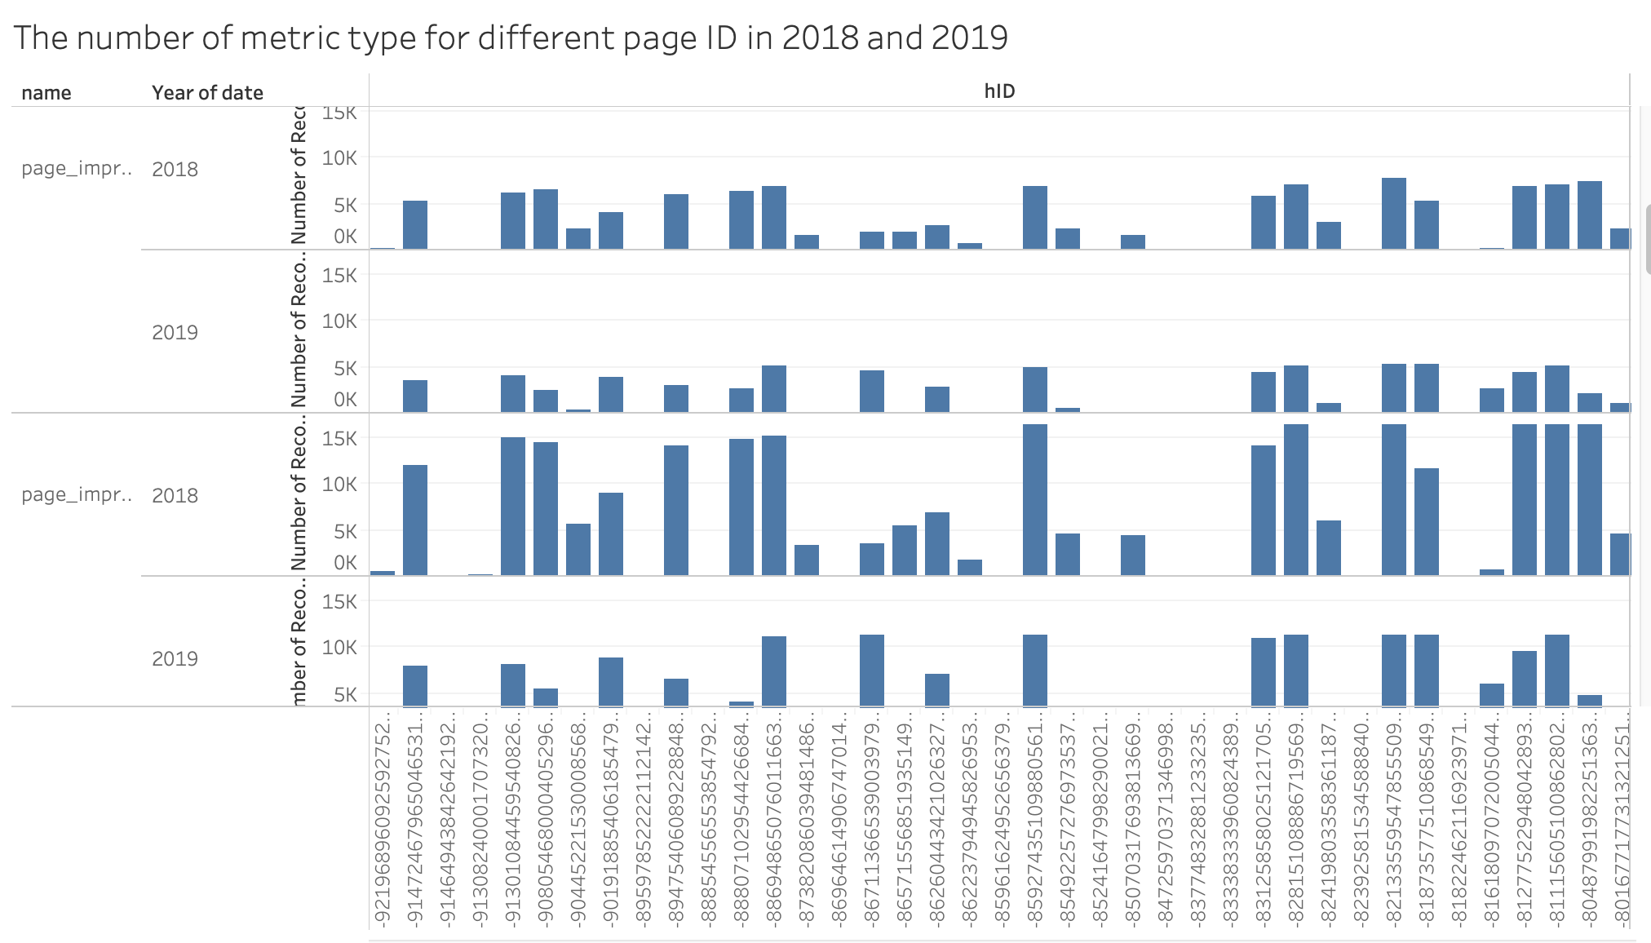
Analysis
From the graph, The number of page impression, page fans online and page video views can be learned. For different page, there were different number of metrics in 2018 and 2019, there were increase in the number of metrics from 2018 to 2019, also decrease in the number of metrics for different page.
The Number of Metric Type for Different Page ID in 2018 and 2019

Slide 9
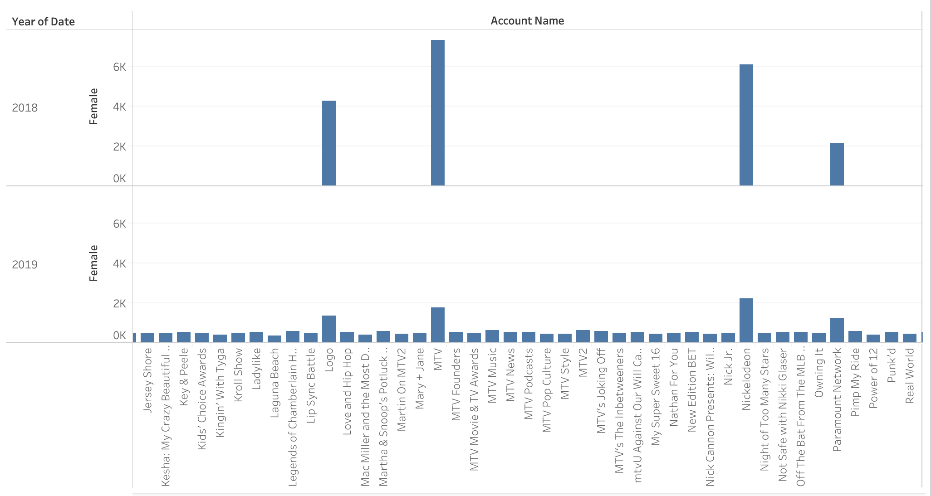
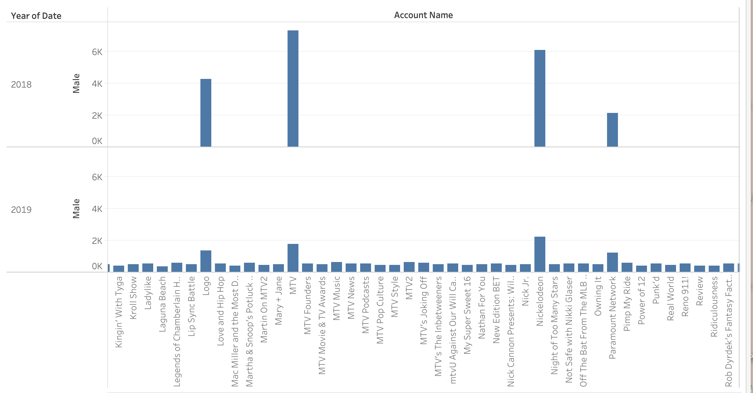
Analysis
The Number of Female for Different Accounts in 2018 and 2019.
From the graphs, the number of female and male audience for different accounts in 2018 and 2019 can be learned.
Some accounts had increased number of female and male audience, but some had decreased female and male audience.
The Number of Male for Different Accounts in 2018 and 2019.

Slide 10
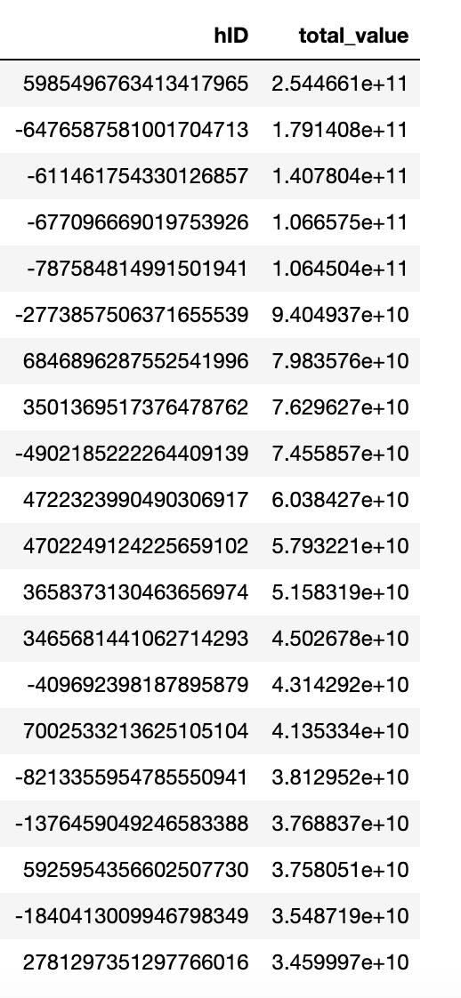
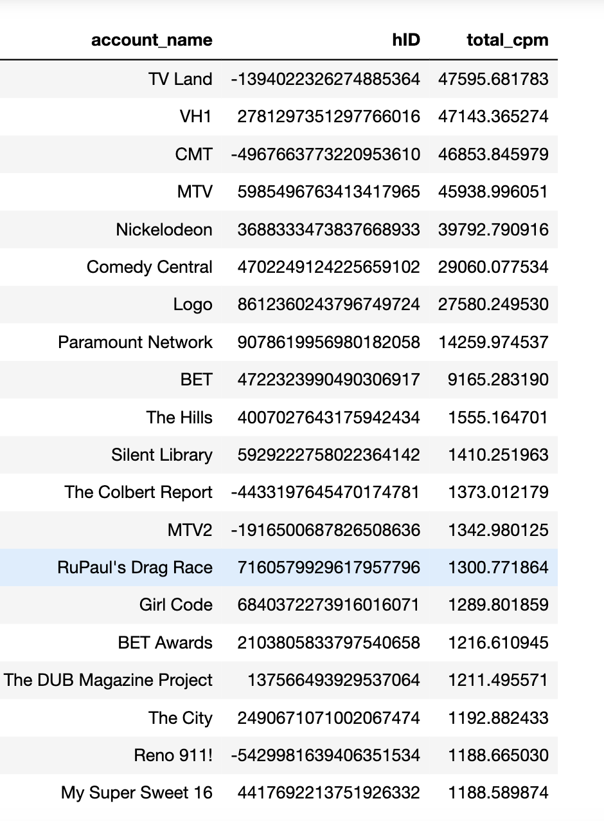
Analysis
The highest total value is 2.544661e+11 and the highest total CPM is 47595.78, there is a big gap between the biggest profit Viacom have and biggest investment that Viacom input. Only from this evidence, it’s obvious that Viacom won’t loss money on the social media campaign.
Top 20 Page ID Ranked by Total Value
Top 20 Account Name Ranked by Total CPM

Slide 11
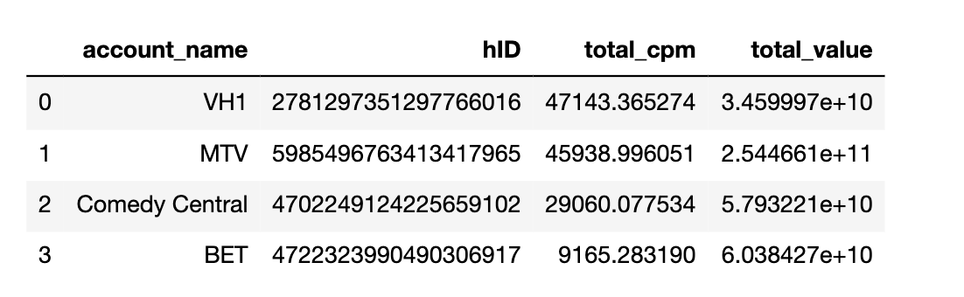
Analysis
From the table, it can be learned that VH1, MTV, Comedy Central and BET have both high total CPM and value. Therefore, the CPM that invested in these accounts were worthy because they also had high total value.
However, combine this table and two tables in previous graph, it can be learned that there are16 accounts that have high total CPM but low total value such as TV Land, CMT, The Hills and Logo etc.
Accounts that Both Total CPM and Total Value Are in The Top 20

Slide 12
Results/Findings
In some accounts, whether the content was from paid distribution such as advertisements or unpaid distribution such as posts, stories or social information wouldn’t affect the number of times showed on people’s screen, but for some accounts, paid or unpaid distribution can affect the outcomes.
The biggest CPM value was in February 2019 and the lowest CPM value was in May 2019. The higher CPM value means the lower success in advertisement and promotion campaign (Memon,2020).
There were many accounts have lower CPM values in 2019 when compared with the values in 2018. The promotions and advertisements activities were more successful in 2019 than 2018 for some accounts.
The number of female and male audience for different accounts had changed in 2018 and 2019.
It’s effective to analyze the audience for different accounts and do target promotions and advertisings.
It is worthy to invest social campaign cost on VH1, MTV, Comedy Central and BET.

Slide 13
Failed Approach
The outcome is not clear to put statistics of both female and male for different accounts in 2018 and 2019.
The types of metric column are different, there are location, numbers and age etc. Therefore, it’s hard to analyze the list of metric.
It’s not easy to do data cleaning for every page_level_data datasets, for example, classify different types of metric in every datasets.

Slide 14
Recommendations
As for the accounts that have lower different outcomes between paid distributions and unpaid distributions, Viacom can try to increase the advertisement amount for advertisers because the outcome is similar with the contents that not includes advertisements.
As for advertisements that need to attract more female customers, they should advertise on the accounts that have more female audience (Langford,2019).
Analyze why the accounts that have decrease in CPM values from 2018 to 2019, there can be effective promotion and advertisement strategies they had used, so they can have lower CPM in 2019.
Analyze why May 2019 had the lowest CPM value and why February 2019 had the highest CPM value. Also, learn the strategies that used in May 2019 and avoid mistakes in February 2019.

Slide 15
Future Research
The future objectives of Viacom for its social media channels.
The future development tendency of advertisements and social demographic targeting on social media platforms.
Whether COVID-19 can still affect the entertainment market industry in 2021.
The predictive analysis about audience and statistics of Viacom.

Slide 16
Reference
Christy Ashley, Tracy Tuten (2014). Creative Strategies in Social Media Marketing: An Exploratory Study of Branded Social Content and Consumer Engagement. Psychology & Marketing. Volume 32, Issue 1. https://onlinelibrary-wiley-com.ezproxy.neu.edu/doi/full/10.1002/mar.20761
What is an Executive Summary? https://rasmussen.libanswers.com/faq/171743
Stevie Langford (2019). The Pros and Cons of Demographic Segmentation. https://blog.hurree.co/blog/demographic-segmentation
Viacom Official Website: https://www.viacomcbs.com/
Memon, M. (2020, July 14). 11 Proven Ways to Reduce Your Facebook Ad CPM: Databox Blog. Retrieved November 04, 2020, from https://databox.com/reduce-your-facebook-ad-cpm

